Slide 1
Advanced Sequencing Technologies & Bioinformatics Analysis (Virtual)
http://meetings.cshl.edu/courses.html

Slide 2
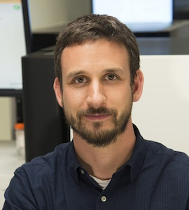
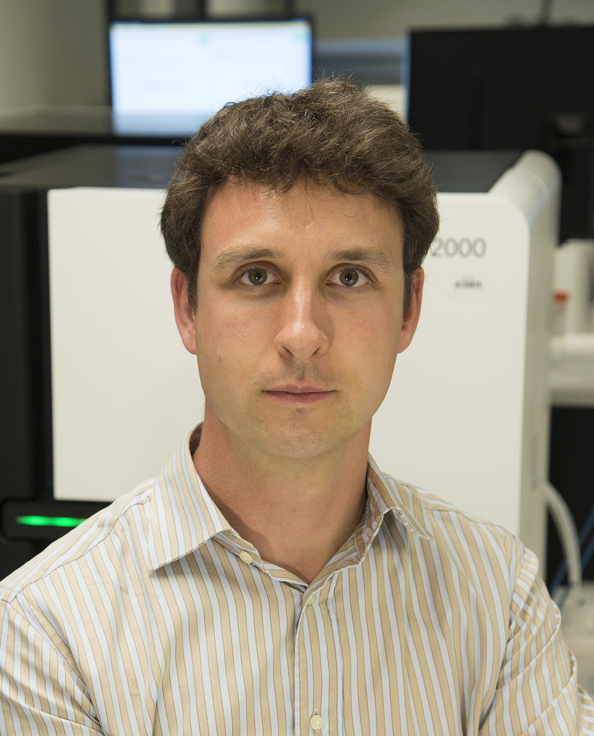
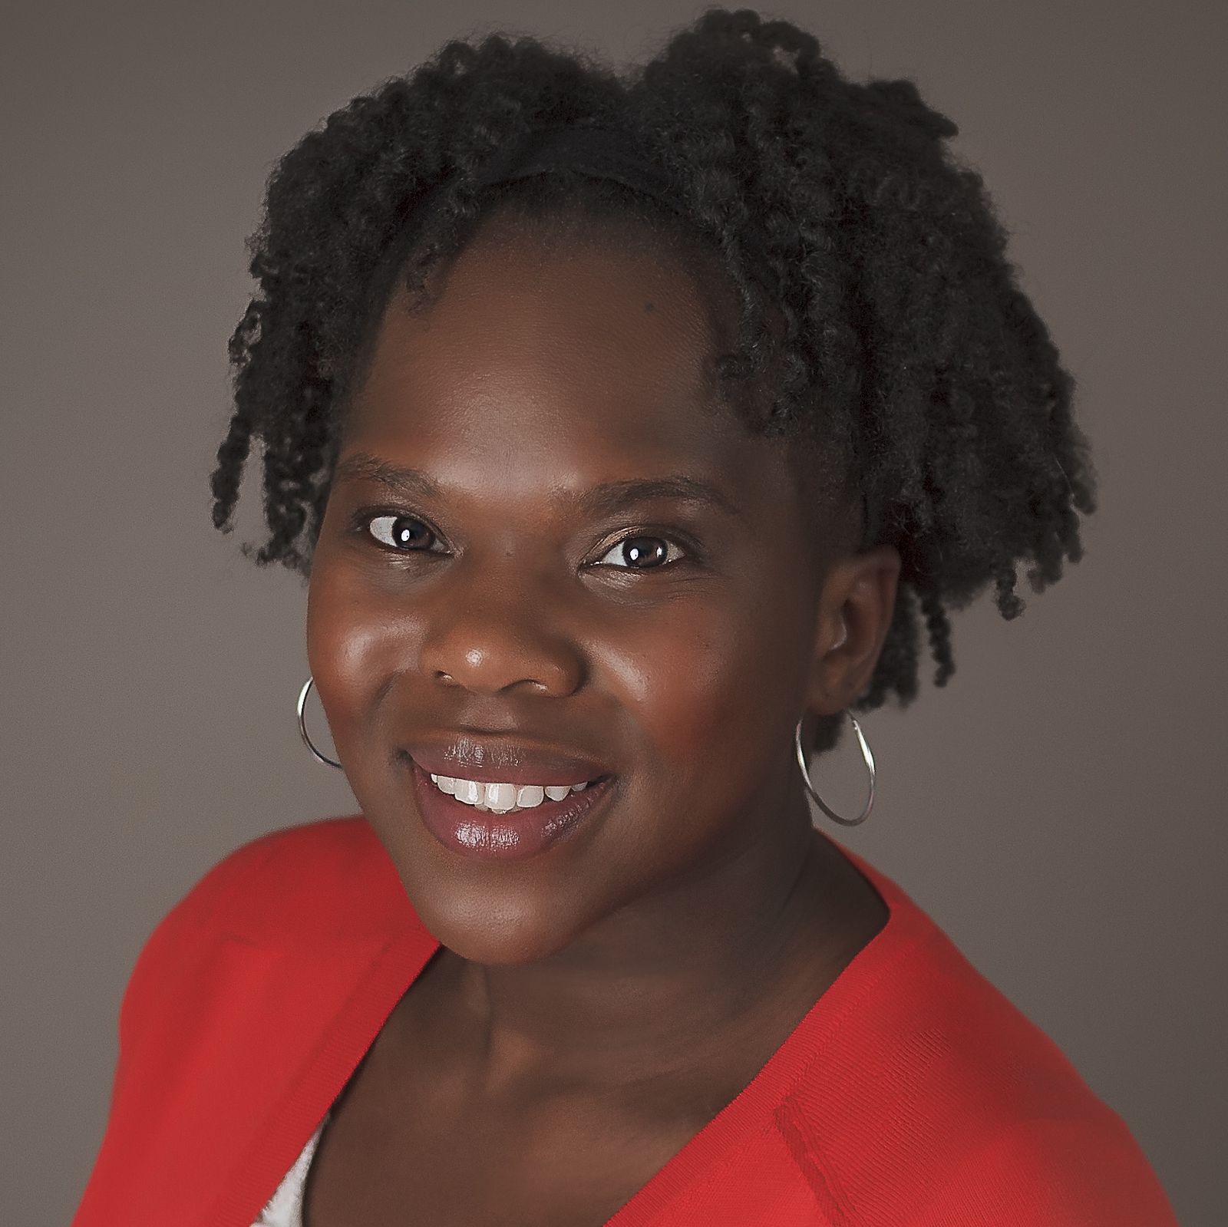
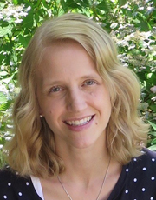
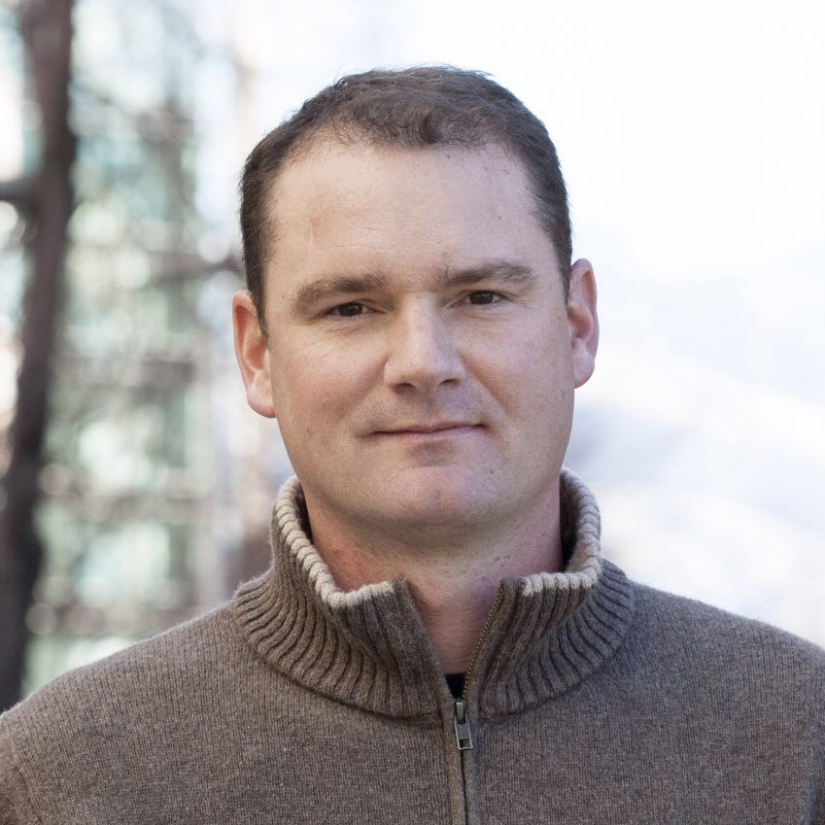
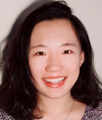
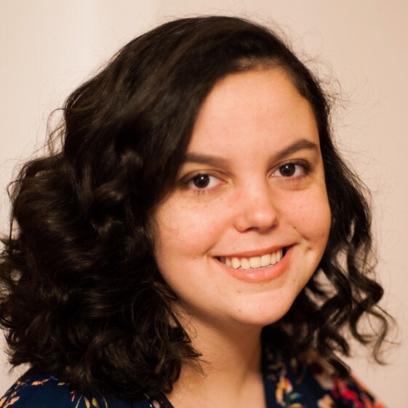
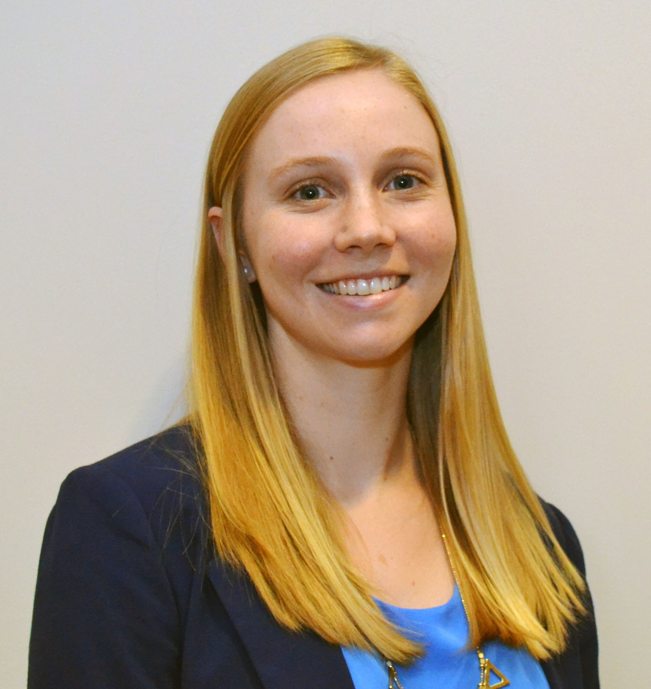
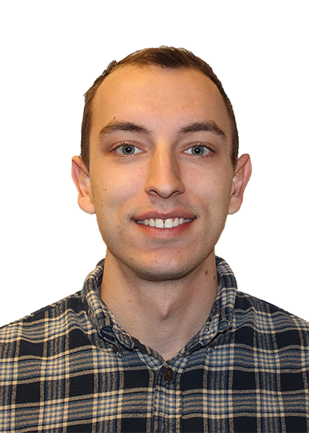
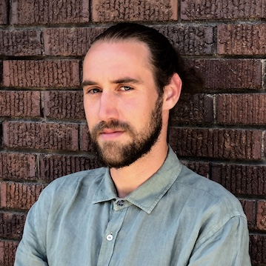



Introductions to Bioinformatics instructors
Malachi Griffith Assistant Professor of Medicine Assistant Professor of Genetics
Assistant Director, MGI
Obi Griffith
Associate Professor of Medicine Associate Professor of Genetics
Assistant Director, MGI
Felicia Gomez
Instructor of Medicine
Allegra Petti
Assistant Professor of Medicine
Aaron Quinlan
Professor of Human Genetics and of Biomedical Informatics
PETTI LAB
Huiming Xia
PhD candidate
Kelsy Cotto
PhD candidate
Megan Richters
PhD candidate
John Chamberlin
Graduate Student
Simone Longo
Graduate Student
griffithlab.org
rnabio.org genviz.org pmbio.org

Slide 3
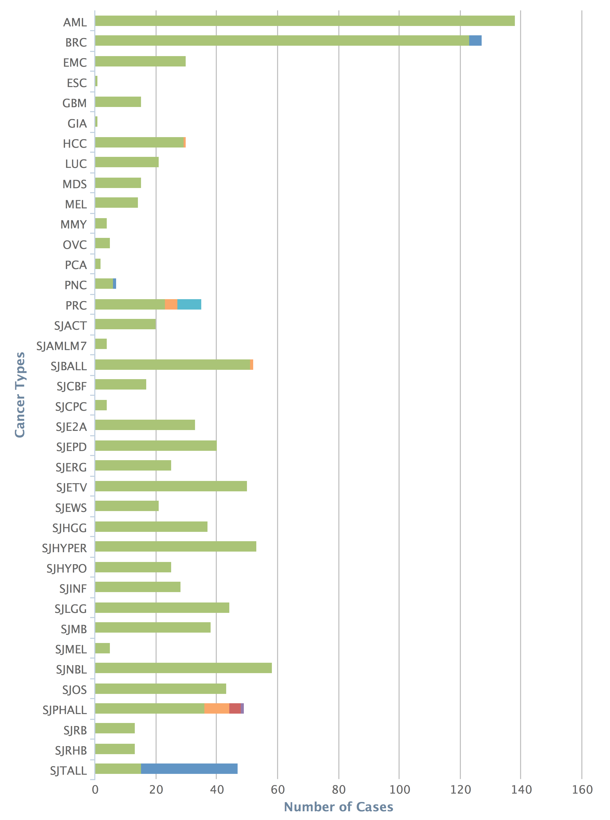
Griffith Lab activities are cancer genomics (informatics) focused: new discovery, translation, method development and training
Cancer genome analysis
Lymphoma
Breast cancer
Mouse models
Targeted sequencing of ER+ cohorts
Non-coding mutation analyses
Small cell lung cancer
OSCC
…
NGS Technology
Regulome sequencing
TCR repertoire sequencing
Precision Medicine for Cancer
Genomics Tumor Board
Immunotherapy (cancer vaccines)
Tool development
RegTools – Regulatory/splicing variant analysis
genVisR – Genome Visualizations in R
DGIdb – drug-gene interactions database
CIViC – Clinical Interpretation of Variants
pVACtools – Cancer vaccine designs
VAtools – VCF annotation
Bioinformatics Training
RNA-seq analysis (rnabio.org)
Genomic Data Visualization (genviz.org)
Precision Medicine Bioinformatics (pmbio.org)
CSHL and CBW
Cancer types
Cases
www.griffithlab.org
Notes:
- With the X-Ten platform we can now sequence almost 2000 whole genomes per month. We will soon have the next iteration of Illumina’s sequencing platform, the NovaSeq 6000, which is expected to double and then triple this capacity over the next few years.

Slide 4
Introduction to SEQTEC Informatics – philosophy and goals
Do “the bioinformatics” for someone, and you help them for a day. Teach someone to do bioinformatics, and you help them for a lifetime.
- Ancient Chinese proverb
Course goals
Learn concepts and develop skills for sequence analysis
Build the foundation for tackling your own analysis challenges
Learn to think like a bioinformatician
Have fun

Slide 5
Course outline
Monday - Introduction to technologies
Tuesday - Bioinformatics basics and NGS data fundamentals
Wednesday - RNAseq expression analysis
Thursday - RNAseq differential expression analysis
Friday - Single cell RNAseq

Slide 6
Course format for a typical day
Lecture
BREAK
Lunch
Practical exercises
BREAK
Practical exercises
Wrap-up and Q&A

Slide 7
Student poll
Not counting the pre-requisites and materials for this course:
Do you consider yourself a bioinformatician?
Are you familiar with linux/command line?
Intermediate?
Expert?
Do you sometimes write code?
Are you familiar with R?
Intermediate?
Expert?
Do you use git/github?
What organism do you work with?
Are you interested in bulk RNAseq (Yes), scRNAseq (No), or both (hand)?
Who has a dual monitor setup?

Slide 8
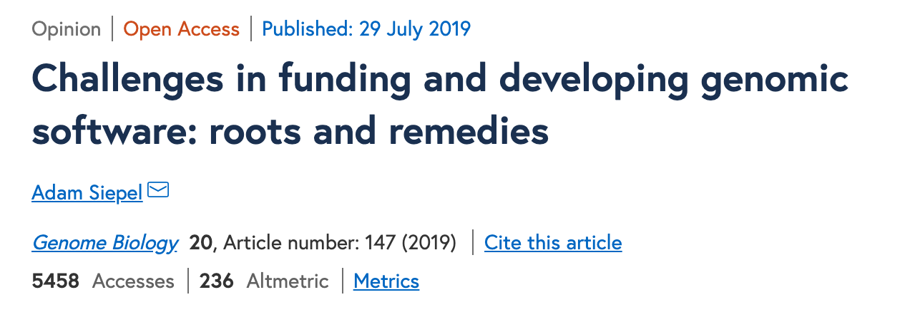
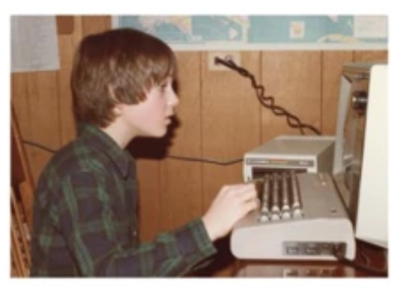
An overview of bioinformatics
Adam Siepel
Professor, Watson School of Biological Sciences; Chair, Simons Center for Quantitative Biology; Cold Spring Harbor Laboratory

